Slide 1
Adversarial Training for Textual Entailment with Knowledge-Guided Examples
Huang Hongru
2019/4/3

Slide 2
Roadmap
Motivation
Adversarial Example Generation
GAN-style training framework
Experiment
Conclusion

Slide 3
Roadmap
Motivation
Adversarial Example Generation
GAN-style training framework
Experiment
Conclusion

Slide 4
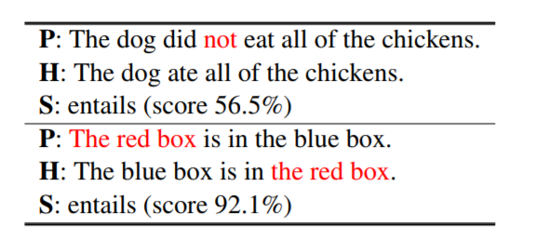
Motivation
Recognizing Textual Entailment (RTE) in moderate data regimes.
RTE: deciding whether a premise text entails a hypothesis text
Moderate data regimes: 5k-10k training examples
Deep learning model generally don’t incorporate large-scale linguistic resource, such as PPDB and Wordnet.
State-of-the-art model fail in some simple linguistic phenomena.
Negation, re-ordering word
Attack these problems by data-augmentation techniques and a GAN-style training framework

Slide 5
Roadmap
Motivation
Adversarial Example Generation
Knowledge-Guided generators
Hand-Defined generators
Neural Generators
GAN-style training framework
Experiment
Conclusion

Slide 6
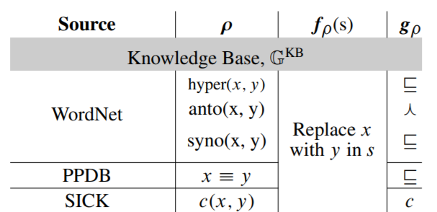
Adversarial Example Generation
Knowledge-Guided Generator
Lexical relationships are highly relevant for entailment models.
Given lexical relation r(x, y), replace word x in the sentence by word y.
hypernym(car, vehicle)
P: A man is driving the car.
H: A man is driving the vehicle.
antonym(happy, sad)
P: A happy man standing in front of the store.
H: A sad man standing in front of the store.
equivalence(search for, is looking for)
P: A man searches for something in the street.
H: A man is looking for something in the street.

Slide 7
Adversarial Example Generation
Hand-Defined Generators
Very few examples of certain but common linguistic structure such as negation.
only 2.11% in the SNLI training set contain negation triggers such as not, n’t, etc.
Only consider negation in this paper
Add a ‘not’ after ‘be’ verb.
Add ‘did’ or ‘do’ in front of verb based on its tense
E.g.:
P: A person is crossing -> H: A person is not crossing
P: A person crossed -> H: A person didn’t cross.

Slide 8
Adversarial Example Generation
Neural Generators
A seq2seq model generate hypothesis h given a premise p and label c.
Similar to paraphrasing, sentence-to-sentence generation.
E.g.:
P: a person on a horse jumps over a broken down airplane.
H: a person is on a horse jumps over a rail, a person jumping over a plane.
C: entailment
H: a person is riding a hose in a field with a dog in a red coat.
C: contradiction

Slide 9
Roadmap
Motivation
Adversarial Example Generation
GAN-style training framework
Framework architecture
Training algorithm
Experiment
Conclusion

Slide 10
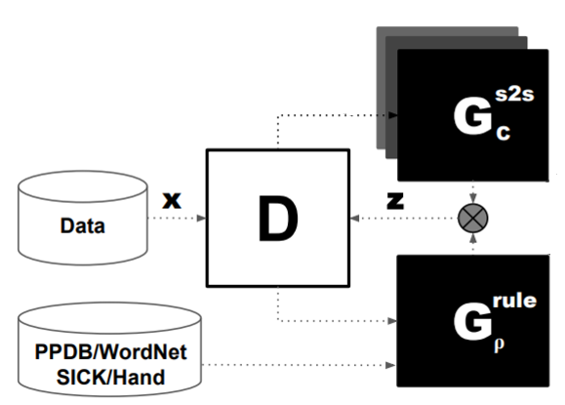
GAN-style training framework

Slide 11
GAN-style training framework
Neural seq2seq generator without describing its structure in detail

Slide 12
GAN-style training framework
Combine two symbolic untrained generators G(KB) and G(H) into single G(rule)

Slide 13
GAN-style training framework
Decomposable attention model (Parikh et al.,2016) with intra-sentence attention

Slide 14
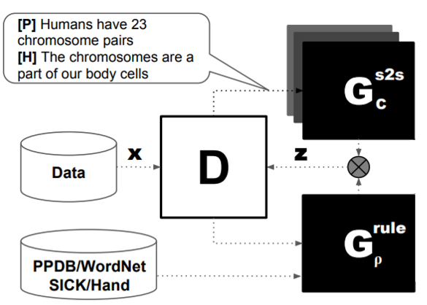
GAN-style training framework
Back propagation
Data flow
Update model

Slide 15
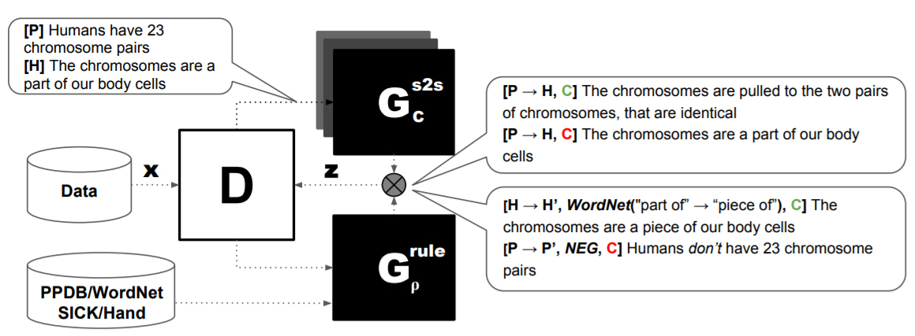
GAN-style training framework
Back propagation
Data flow
Update model

Slide 16
GAN-style training framework
Back propagation
Data flow
Update model

Slide 17
GAN-style training framework
Back propagation
Data flow
Update model

Slide 18
GAN-style training framework
Back propagation
Data flow
Update model

Slide 19
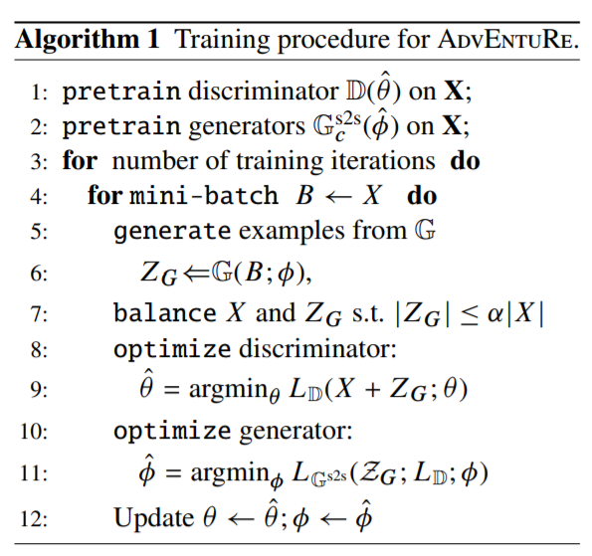
GAN-style training framework

Slide 20
GAN-style training framework

Slide 21
GAN-style training framework

Slide 22
GAN-style training framework

Slide 23
GAN-style training framework

Slide 24
GAN-style training framework

Slide 25
Roadmap
Motivation
Adversarial Example Generation
GAN-style training framework
Experiment
Conclusion

Slide 26
Experiments
Can the proposed method improve an entailment model with moderate amount of data ?
Can iterative GAN-style training lead to an improved discriminator ?
Datasets: SNLI (570k examples) and SciTail (27k examples)
Compare model accuracies on the test sets when using 1%, 10%, 50%, and 100% subsamples of the train and dev sets
To test the hypothesis that adversarial example based training prevents overfitting in small to moderate raining data regimes.

Slide 27
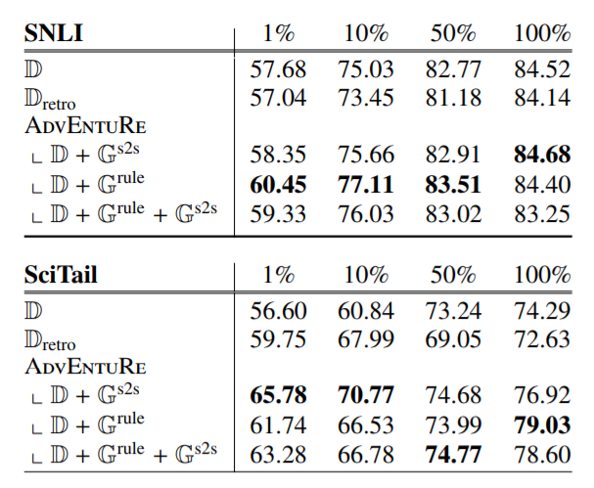
Experiments

Slide 28
Experiments
The proposed method always outperform the baseline models
-- GAN-style training is useful.
Significant improvements are made in less data setting
-- Data augmentation idea works

Slide 29
Experiments
G(rule) is better than G(s2s) on SNLI while G(s2s) is better than G(rule) on SciTail.
Possible reason: G(s2s) is also trained on SNLI. Adversarial example from this generator is not likely to fool the entailment model

Slide 30
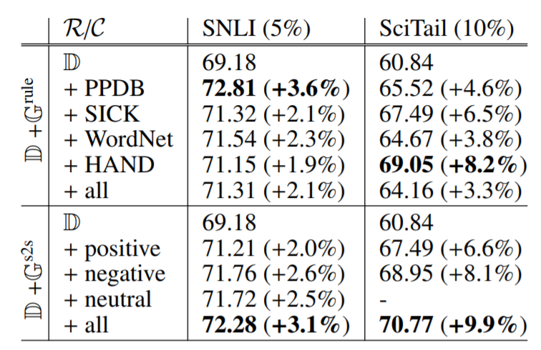
Experiments

Slide 31
Experiments
Most entailment examples in SNLI are minor rewrites. PPDB often contains these simple paraphrases.

Slide 32
Experiments
Simple hand defined rule helps a lot on SciTail

Slide 33
Experiments
Supporting the effectiveness of the GAN framework for penalizing or rewarding generated sentences based on discriminator’s loss

Slide 34
Roadmap
Motivation
Adversarial Example Generation
GAN-style training framework
Experiment
Conclusion

Slide 35
Conclusion
Introduced an adversarial training architecture for RTE in small data
Proposed three different adversarial generators
The effectiveness of this approach is demonstrated by the significant improvements made in the experiment
Future directions:
Rule-based generators can be expanded to cover more phenomena
Neural generators can be extended to incorporate advanced mechanism

Slide 36
Thank you !

